Slide 1
Student Test
By:
JAY BHATTARAI(1BM19IS198)
SACHIN MADHESIYA(1BM19IS206)

Slide 2
Ideas about the project
With this program we are implementing Quiz Test for the students. The program will have 2 types of tests: 1: MCQ Quiz 2: Fill In the Blanks
There is an option for the students to choose the quiz.
We have coded so that, two students can take test of their choice, and the program will compare their marks, and at last their result will be stored inside the file that is named based on their USN.

Slide 3
Student
quizStudent
fillInTheBlanksStudent

Slide 4
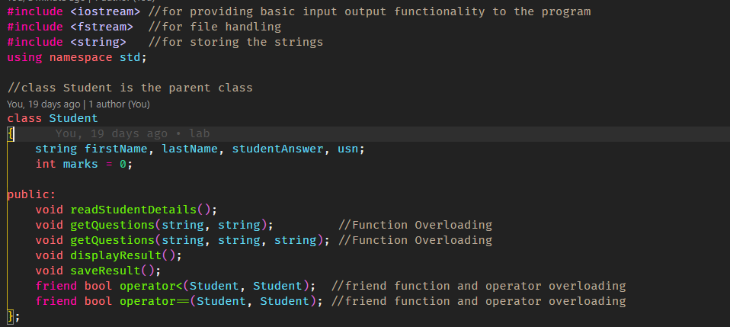

Slide 5
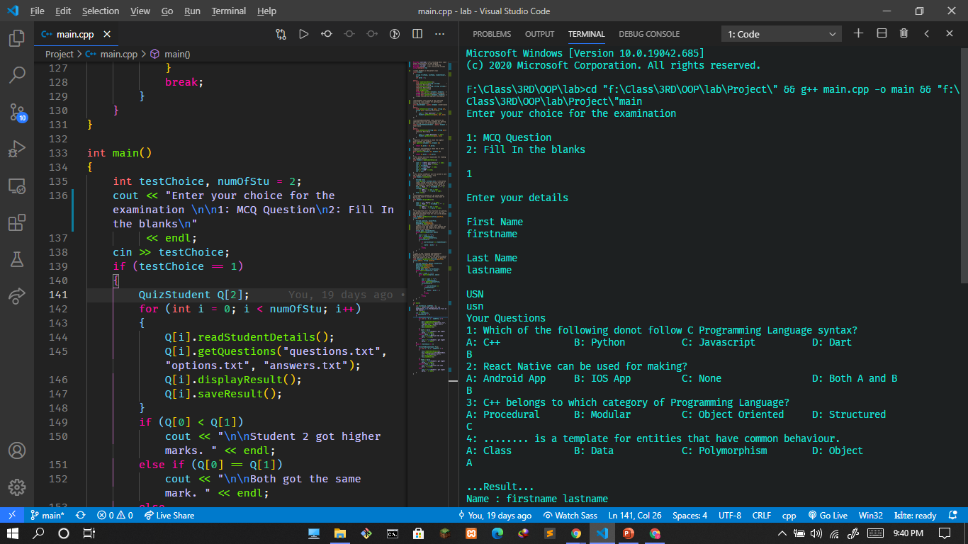

Slide 6
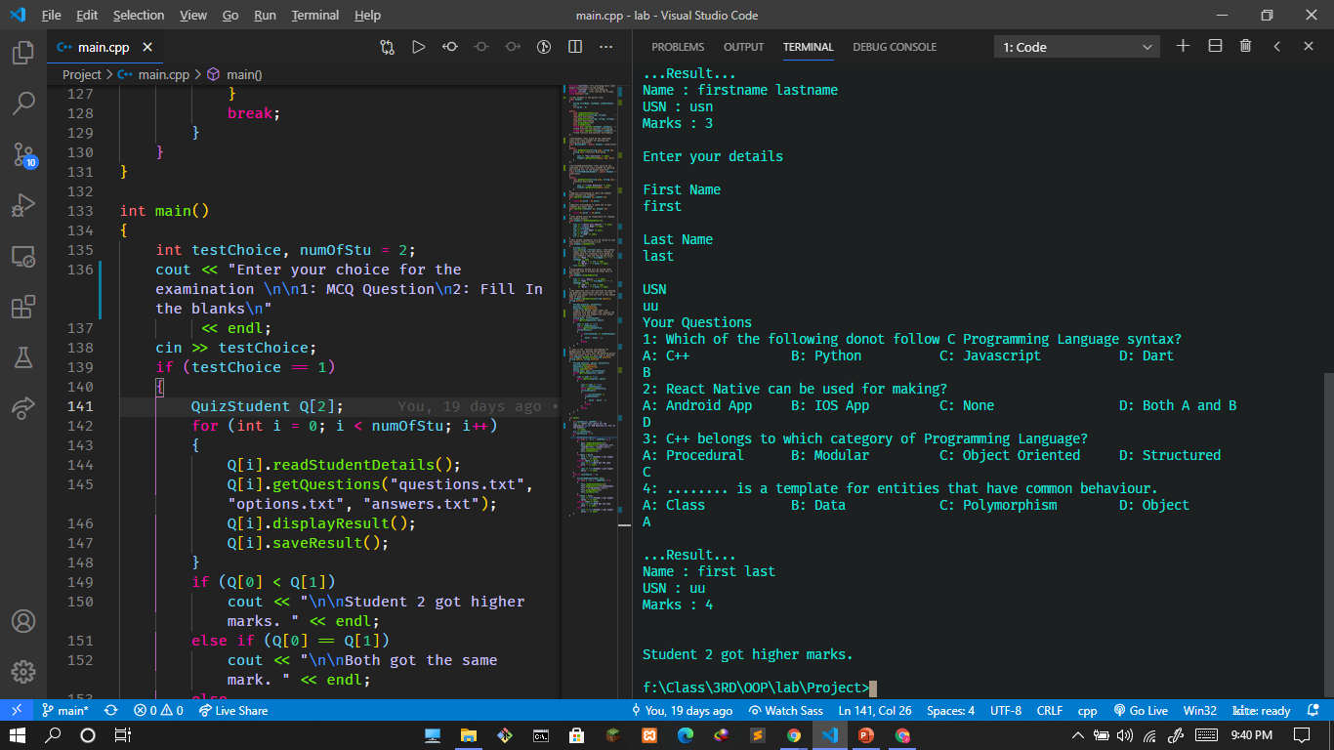
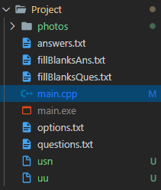

Slide 7
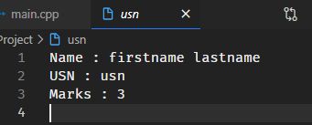
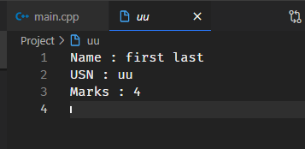

Slide 8
Thank You

